Slide 1
Grid and Cloud Computing
Anda Iamnitchi
CIS 6930 Spring 2011
anda@cse.usf.edu

Slide 2

P2P Systems as Resource-Sharing Environments
Users:
  Millions
  Anonymous individuals
Resources:
  Data, storage, or network resources (or computation?)
  Owned/administered (?) by user
  Intermittent participation:
    Gnutella: 60 min. (‘01)
    MojoNation: 1/6 users always connected (‘01)
    Overnet: 50% nodes available 70% of time over a week (‘02)
Applications: file retrieval, event notifications, network measurements
Approach: vertically integrated solutions

Slide 3

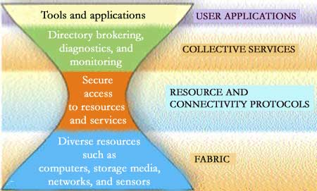
Grid: Resource-Sharing Environment
Users:
  1000s from 10s institutions
  Well-established communities
Resources:
  Computers, data, instruments, storage, applications
  Owned/administered by institutions
Applications: data- and compute-intensive processing
Approach: common infrastructure

Slide 4










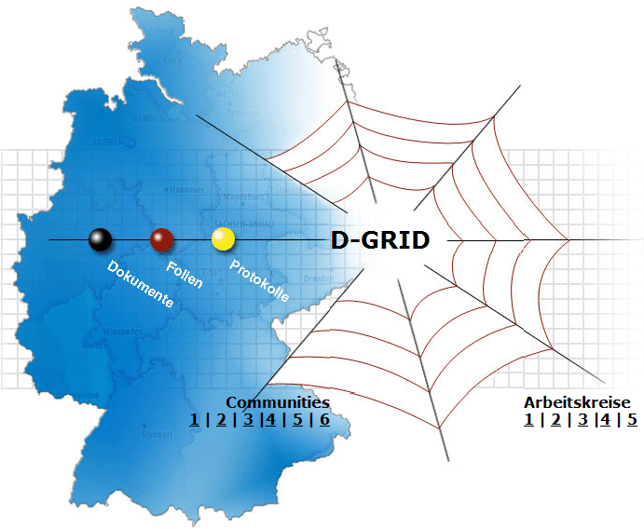



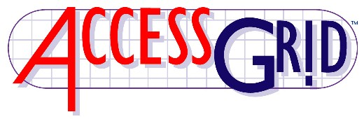








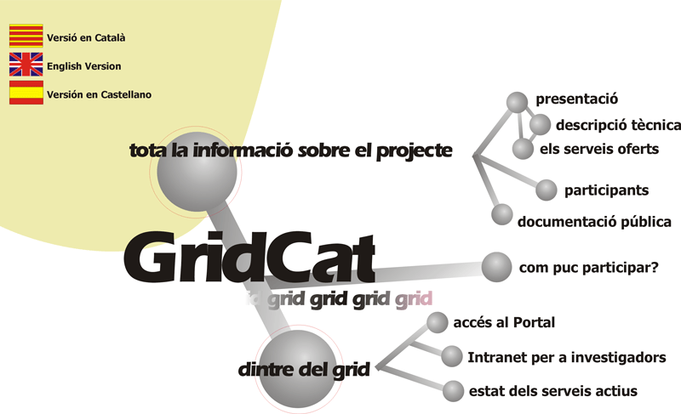








Slide 5
Grids vs. P2P Systems
Functionality &
infrastructure
Large scale
  Weaker trust assumptions
  Ease of integration
No centralized authority
Intermittent resource/user participation
Diversity in:
  Shared resources
  Sharing characteristics
Variable technical support
Infrastructure (sharable services)
  Support for diverse applications
Grids
P2P
Scale & volatility
On Death, Taxes, and the Convergence of Grid and P2P Systems, Foster and Iamnitchi, IPTPS’03

Slide 6
Grid: Definitions
Definition 1: Infrastructure that provides dependable, consistent, pervasive, and inexpensive access to high-end computational capabilities (1998)
Definition 2: A system that coordinates resources not subject to centralized control, using open, general-purpose protocols to deliver nontrivial Quality of Service (2002)

Slide 7

An Example: The Globus Toolkit
- Initially developed at Argonne National Lab/University of Chicago and ISI/University of Southern California

Slide 8
How It Started
While helping to build/integrate a diverse range of distributed applications, the same problems kept showing up over and over again.
  Too hard to keep track of authentication data (ID/password) across institutions
  Too hard to monitor system and application status across institutions
  Too many ways to submit jobs
  Too many ways to store & access files and data
  Too many ways to keep track of data
  Too easy to leave “dangling” resources lying around (robustness)

Slide 9
grid architecture in a nutshell

Slide 10
Forget Homogeneity!
Trying to force homogeneity on users is futile. Everyone has their own preferences, sometimes even dogma.
The Internet provides the model…

Slide 11
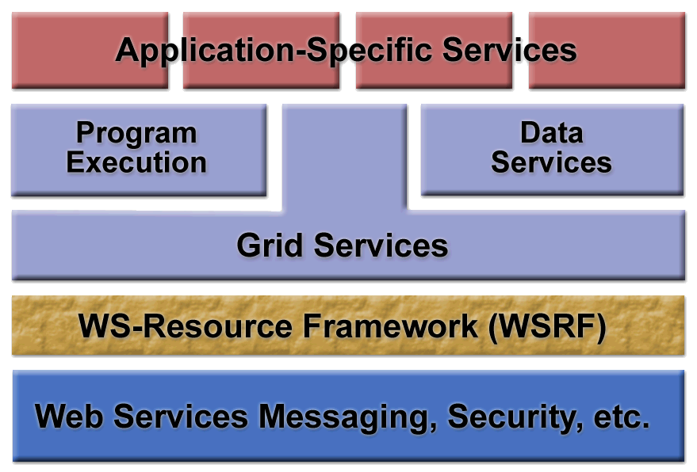
From Theory to Practice

Slide 12
Building a Grid (in Practice)
Building a Grid system or application is currently an exercise in software integration.
  Define user requirements
  Derive system requirements or features
  Survey existing components
  Identify useful components
  Develop components to fit into the gaps
  Integrate the system
  Deploy and test the system
  Maintain the system during its operation
This should be done iteratively, with many loops and eddys in the flow.

Slide 13

How it Really Happens
Compute
Server
Simulation
Tool
Web
Browser
Compute
Server
Web
Portal
Registration
Service
Camera
Data
Viewer
Tool
Telepresence
Monitor
Camera
Chat
Tool
Database
service
Data
Catalog
Database
service
Credential
Repository
Database
service
Certificate
authority
Users work with client applications
Application services organize VOs & enable access to other services
Collective services aggregate &/or virtualize resources
Resources implement standard access & management interfaces

Slide 14
How it Really Happens (without Globus)
A
Compute
Server
Simulation
Tool
Web
Browser
B
Compute
Server
Web
Portal
Registration
Service
Camera
Data
Viewer
Tool
Telepresence
Monitor
Application Developer | 10
Off the Shelf | 12
Globus Toolkit | 0
Grid Community | 0
Camera
Chat
Tool
C
Database
service
Data
Catalog
D
Database
service
Credential
Repository
E
Database
service
Certificate
authority
Users work with client applications
Application services organize VOs & enable access to other services
Collective services aggregate &/or virtualize resources
Resources implement standard access & management interfaces

Slide 15
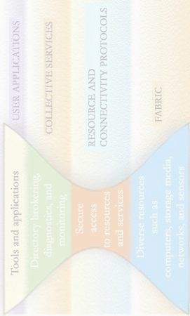
How it Really Happens (with Globus)
Globus
GRAM
Compute
Server
Simulation
Tool
Web
Browser
Globus
GRAM
Compute
Server
CHEF
Globus Index
Service
Camera
Data
Viewer
Tool
Telepresence
Monitor
Application Developer | 2
Off the Shelf | 9
Globus Toolkit | 4
Grid Community | 4
Camera
CHEF Chat
Teamlet
Globus
DAI
Database
service
Globus
MCS/RLS
Globus
DAI
Database
service
MyProxy
Globus
DAI
Database
service
Certificate
Authority
Users work with client applications
Application services organize VOs & enable access to other services
Collective services aggregate &/or virtualize resources
Resources implement standard access & management interfaces
Notes:
Implementations are provided by a mix of
Application-specific code
“Off the shelf” tools and services
Tools and services from the Globus Toolkit
Tools and services from the Grid community (compatible with GT)
Glued together by…
Application development
System integration

Slide 16
What Is the Globus Toolkit?
The Globus Toolkit is a collection of solutions to problems that frequently come up when trying to build collaborative distributed applications.
Not turnkey solutions, but building blocks and tools for application developers and system integrators.
  Some components (e.g., file transfer) go farther than others (e.g., remote job submission) toward end-user relevance.
To date, the Toolkit has focused on simplifying heterogeneity for application developers.
The goal has been to capitalize on and encourage use of existing standards (IETF, W3C, OASIS, GGF).
  The Toolkit also includes reference implementations of new/proposed standards in these organizations.

Slide 17
How To Use the Globus Toolkit
By itself, the Toolkit has surprisingly limited end user value.
  There’s very little user interface material there.
  You can’t just give it to end users (scientists, engineers, marketing specialists) and tell them to do something useful!
The Globus Toolkit is useful to application developers and system integrators.
  You’ll need to have a specific application or system in mind.
  You’ll need to have the right expertise.
  You’ll need to set up prerequisite hardware/software.
  You’ll need to have a plan.

Slide 18
Globus Toolkit Components
G
T
4
Delegation
Service
Community
Scheduler
Framework
[contribution]
Python WS Core
[contribution]
C WS Core
G
T
3
Community
Authorization
Service
OGSA-DAI
[Tech Preview]
Web Services
Components
WS
Authentication
Authorization
Reliable
File
Transfer
Grid
Resource
Allocation Mgmt
(WS GRAM)
Monitoring
& Discovery
System
(MDS4)
Java WS Core
G
T
2
Pre-WS
Authentication
Authorization
GridFTP
Grid
Resource
Allocation Mgmt
(Pre-WS GRAM)
Monitoring
& Discovery
System
(MDS2)
C Common
Libraries
Non-WS
Components
G
T
3
Replica
Location
Service
XIO
G
T
4
Credential
Management
Security
Data Management
Execution Management
Information Services
Common
Runtime

Slide 19
From Grids to Cloud Computing
Logical steps:
  Make the grids public
  Provide much simpler interfaces (and more limited control)
  Charge usage of resources
    Instead of relying on implicit incentives from science collaborations
    Ideally, a “pay-as-you-go” rate
In reality:
  Different history
    Cloud computing as utility computing (1966 paper)
However, the promise of cloud computing finds a great user base in science grids due to:
  Intense computations
  Huge amounts of storage needs
Much of the Grid research community is now working on clouds
  How much of that is only rebranding is useful to understand

Slide 20
Outline
What is Cloud Computing?
Why now?
Cloud killer apps
Economics for users
Economics for providers
Challenges and opportunities
Implications
Case study: Amazon Web Services

Slide 21
What is Cloud Computing?
Old idea: Software as a Service (SaaS)
  Def: delivering applications over the Internet
Recently: “[Hardware, Infrastructure, Platform] as a service”
  Poorly defined so we avoid all “X as a service”
Utility Computing: pay-as-you-go computing
  Illusion of infinite resources
  No up-front cost
  Fine-grained billing (e.g. hourly)
Cloud computing: a new term for the long-held dream of utility computing (first defined in 1966)
  Refers to both the application delivered as services over the Internet and the hardware and software systems in the datacenters that provide those services.

Slide 22
Why Now?
Experience with very large datacenters
  Unprecedented economies of scale
Other factors
  Pervasive broadband Internet
  Fast x86 virtualization
  Pay-as-you-go billing model
  Standard software stack

Slide 23
Spectrum of Clouds
Instruction Set VM (Amazon EC2, 3Tera)
Bytecode VM (Microsoft Azure)
Framework VM
  Google AppEngine, Force.com
Lower-level,
Less management
Higher-level,
More management
EC2
Azure
AppEngine
Force.com

Slide 24
Cloud Killer Applications
Mobile and web applications
Extensions of desktop software
  Matlab, Mathematica
Batch processing / MapReduce
  Oracle at Harvard, Hadoop at NY Times

Slide 25

Economics of Cloud Users
Pay by use instead of provisioning for peak
Capacity
Demand
Capacity
Demand
Time
Time
Static data center
Data center in the cloud
Unused resources

Slide 26
Economics of Cloud Users
Risk of over-provisioning: underutilization
Capacity
Unused resources
Demand
Time
Static data center

Slide 27

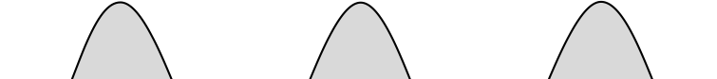
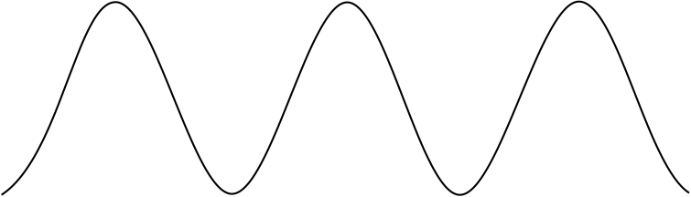
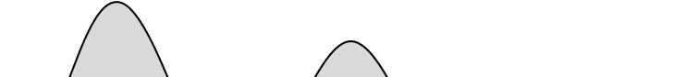

Economics of Cloud Users
Heavy penalty for under-provisioning
Capacity
Demand
Capacity
1
2
3
Time (days)
Demand
Lost revenue
1
2
3
Time (days)
Capacity
Demand
1
2
3
Time (days)
Lost users

Slide 28
Economics of Cloud Providers (1)
5-7x economies of scale [Hamilton 2008]
Resource | Cost in Medium Data Centers | Cost in Very Large Data Centers | Ratio
Network | $95 / Mbps / month | $13 / Mbps / month | 7.1x
Storage | $2.20 / GB / month | $0.40 / GB / month | 5.7x
Administration | ≈140 servers/admin | >1000 servers/admin | 7.1x

Slide 29
Economics of Cloud Providers (2)
Price per KWH | Where | Possible Reasons Why
3.6¢ | Idaho | Hydroelectric power; not sent long distance.
10.0¢ | California | Electricity transmitted long distance over the grid; limited transmission lines in Bay Area; no coal fired electricity allowed in California.
18.0¢ | Hawaii | Must ship fuel to generate electricity.
Price of kilowatt-hours of electricity by region.

Slide 30
Economics of Cloud Providers (3)
Extra benefits
  Amazon: utilize off-peak capacity
  Microsoft: sell .NET tools
  Google: reuse existing infrastructure

Slide 31
Adoption Challenges
Challenge | Opportunity
Availability: Outages DDoS | Multiple providers & Data Centers
Data lock-in | Standardization
Data Conﬁdentiality and Auditability | Encryption, VLANs, Firewalls; Geographical Data Storage

Slide 32
Growth Challenges
Challenge | Opportunity
Data transfer bottlenecks | FedEx-ing disks, Data Backup/Archival - Mailing disks is already provided by Amazon
Performance unpredictability | Improved VM support, flash memory, scheduling VMs
Scalable storage | Invent scalable store
Bugs in large distributed systems | Invent Debugger that relies on Distributed VMs
Scaling quickly | Invent Auto-Scaler that relies on ML; Snapshots

Slide 33
Policy and Business Challenges
Challenge | Opportunity
Reputation Fate Sharing | Offer reputation-guarding services like those for email
Software Licensing | Pay-for-use licenses; Bulk use sales

Slide 34
Long Term Implications
Application software:
  Cloud & client parts, disconnection tolerance
Infrastructure software:
  Resource accounting, VM awareness
Hardware systems:
  Containers, energy proportionality

Slide 35
Some Views On Cloud Computing
“The interesting thing about Cloud Computing is that we’ve redefined Cloud Computing to include everything that we already do. . . . I don’t understand what we would do differently in the light of Cloud Computing other than change the wording of some of our ads.”
Larry Ellison (Oracle’s CEO), quoted in the Wall Street Journal, September 26, 2008

Slide 36
“A lot of people are jumping on the [cloud] bandwagon, but I have not heard two people say the same thing about it. There are multiple definitions out there of the cloud.”
Andy Isherwood, Hewlett-Packard’s Vice President of European Software Sales, quoted in ZDnet News, December 11, 2008

Slide 37
“It’s stupidity. It’s worse than stupidity: it’s a marketing hype campaign. Somebody is saying this is inevitable — and whenever you hear somebody saying that, it’s very likely to be a set of businesses campaigning to make it true.”
Richard Stallman, quoted in The Guardian, September 29, 2008

